Slide 1
Steering Committee Long Island Population Health Improvement Program (LIPHIP)
September 20, 2017

Slide 2
Conferences and Presentations
Visual Storytelling Training, Central NY PHIP
National Walking Summit, St. Paul, MN

Slide 3
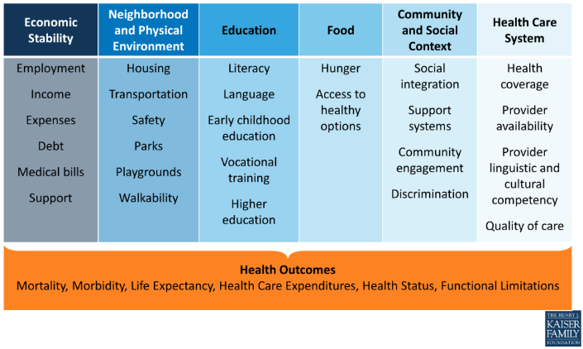
Collective Impact Think Tank
Friday September 29, 2017
Vendor: FSG, Laura Herman, Managing Director
Expectation on Outcomes

Slide 4
Future of PHIP and Program Sustainability
Vision of Long Island Population Health Program
Strengths/Opportunities
Weakness/Threats
sustainability

Slide 5
Updated Community Member Survey Data
Refer to Summary of Findings

Slide 6
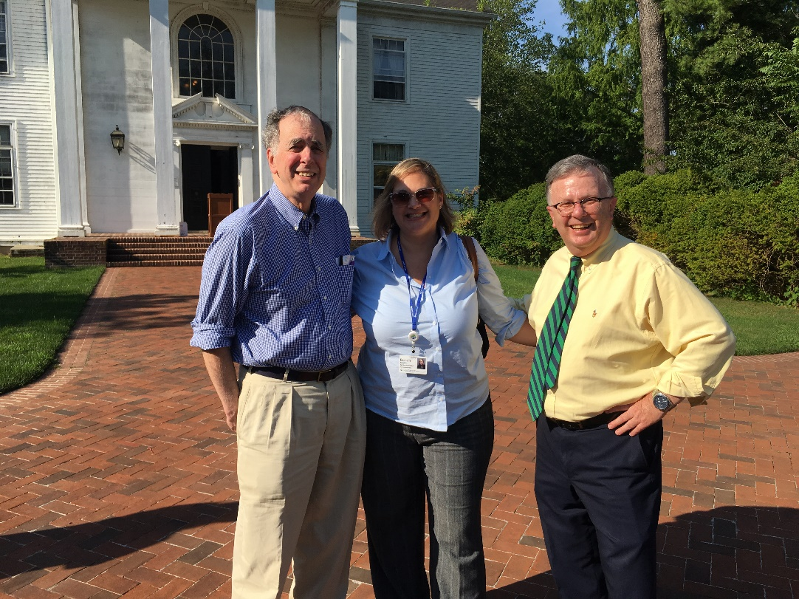
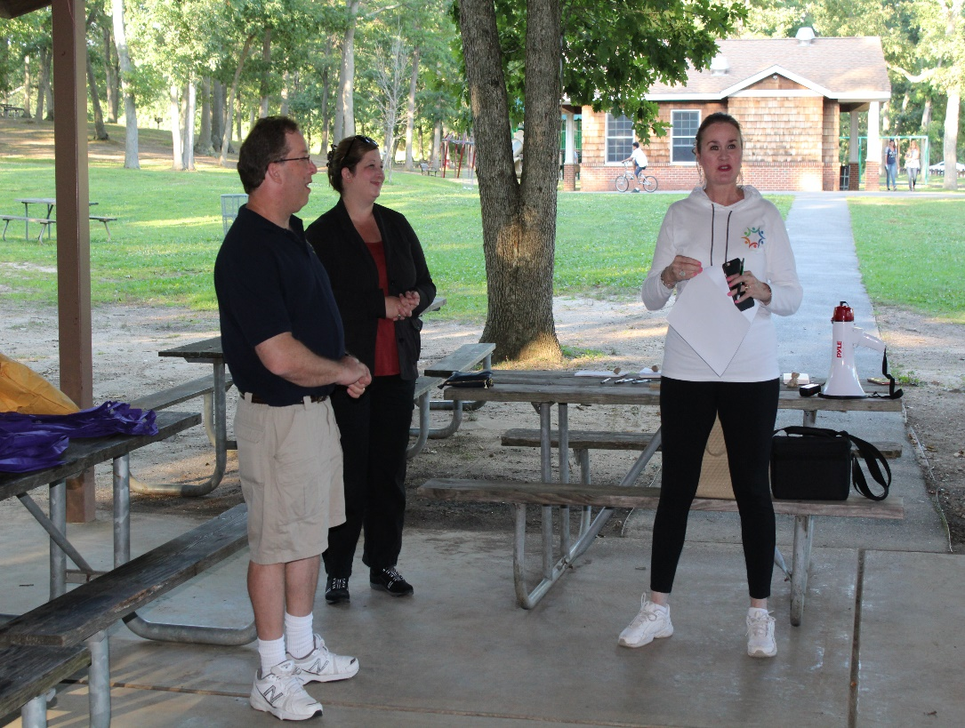
Summer Walking Events
Belmont Lake State Park
Bethpage State Park

Slide 7
Feedback and Suggestions from Steering Committee Members

Slide 8
2017 Upcoming Meetings
November 29, 8:30 – 9:30 a.m.

